Slide 1
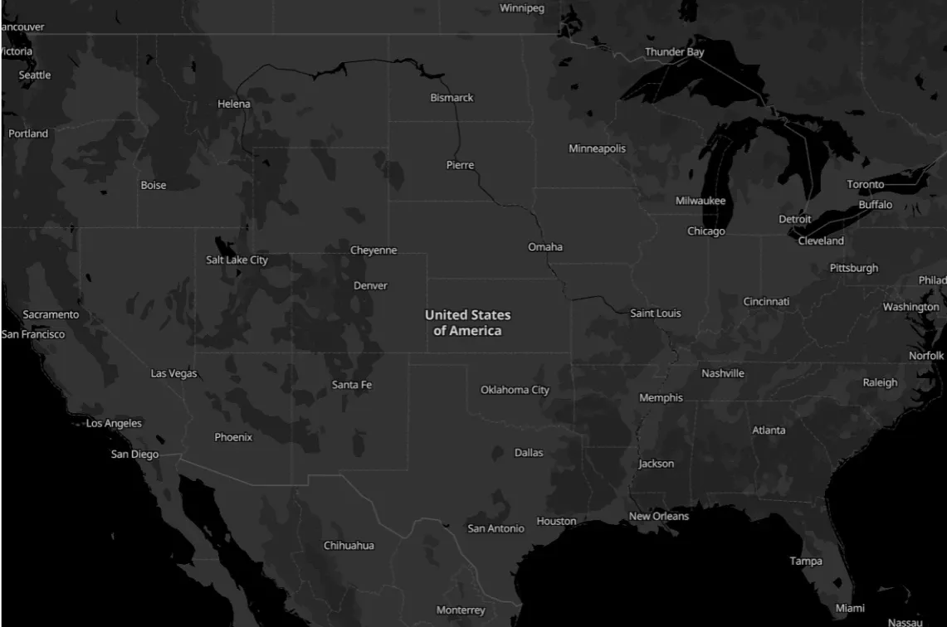

Crimes Data Analysis
Group 6
2025
01

Slide 2

Team Members & Roles:
Reem Alsaif
Lama Almoutiry
Mousa Alatwi
Data Cleaning
EDA
(Plots,Maps)
Data Cleaning
EDA
(Analysis, Plots)
Dashboard
EDA
(Maps Visuals)
2025
02

Slide 3
Content
01
02
03
04
Problem Statment
Ojectives
Dataset Overview
Methodology
05
06
07
Dashboard & Key Insights
Conclusion
Appendix

Slide 4
Problem Statement
High Crime rates affect public safety and law enforcement.
Difficult to understand crime patterns without proper analysis.
Lack of clear visualization makes it hard to identify hotspots quickly.

Slide 5
Objectives
Explore geospatial crime patterns using longitude and latitude coordinates.
Perform a full EDA process to understand data quality, distributions, and trends.
Visualize crime data using interactive maps to identify hotspots and temporal patterns.
Develop a Streamlit dashboard for interactive exploration of crime patterns and insights.
Provide actionable insights to support data-driven decisions for public safety and resource allocation.

Slide 6
Data Overview
Name: Chicago crime dataset
Data Source
Chicago Data Portal
Time Period: January 1, 2022 - December 31, 2022
Purpose: Analyze crime trends and patterns for public safety improvement
Scope: Crimes reported in Chicago city in districts
Dataset Size: 239,908 rows × 22 columns

Slide 7


Data Overview
Name: Chicago crime dataset
Data Source
Chicago Data Police
Time Period: January 1, 2022 - December 31, 2022
Purpose: Analyze crime trends and patterns for public safety improvement
Scope: Crimes reported in Chicago city in districts
Dataset Size: 239,908 rows × 22 columns

Slide 8
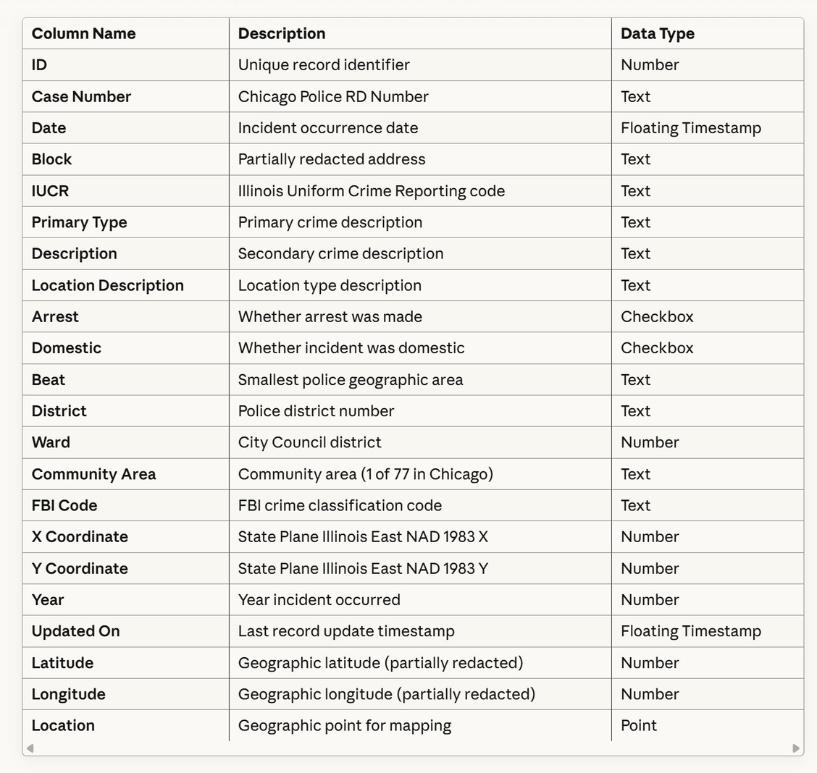
Data Overview
Features:

Slide 9
Data Overview
Features:
Column | Description | Example
Date | Incident occurrence date | 2023-07-15 14:35:00
Primary Type | Primary crime description | Theft, Battery, Assault
Description | Subcategory of the primary description. | Over 500$
Domestic | Whether incident was domestic | True / False
Arrest | Whether arrest was made | True / False

Slide 10
Data Overview
Features:
Column | Description | Example
Location Description | Description of the location where the incident occurred. | Street, Apartment, Sidewalk
District | Police district number | 8, 12, 25
Community Area | one of 77 community areas | 32, 45, 67
Latitude | The latitude of the location | 41.8781
Longitude | The longitude of the location | -87.6298

Slide 11


Methodology
2
Data Cleaning
4
Maps
Visualization
1
Data Overview
3
EDA
5
Dashboard & insights

Slide 12
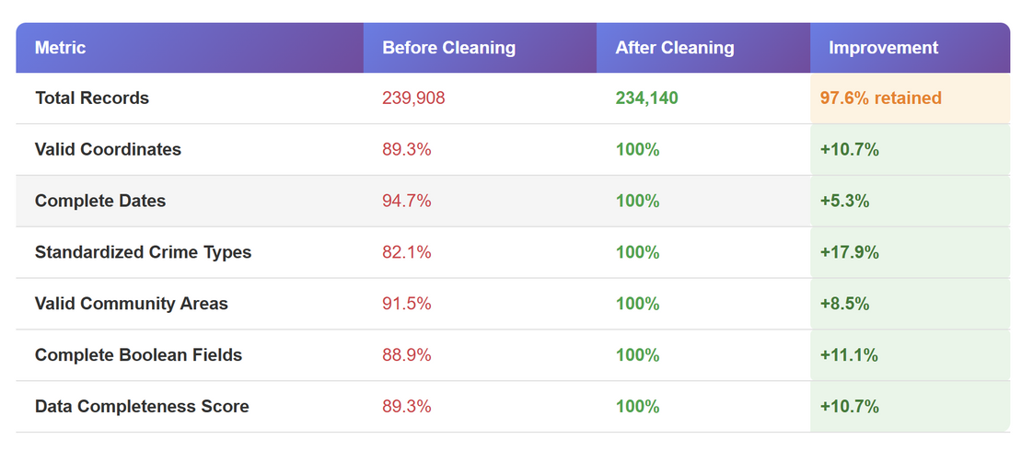
Methodology– EDA & Data Cleaning
2. Data Cleaning :
Duplicates: Checked for identical records
Missing Values: Identified in coordinates, dates, crime types
Validated coordinate ranges: Latitude (41.6-42.0), Longitude (-87.9 to -87.5)
Date format conversion: Multiple formats

Slide 13
Methodology– Data Cleaning
Handle Missing Values
Filled the Null values:
Location Description ⟶ ‘unknown’
Dropped rows with missing values
in Ward, Community Area, Latitude and Langitude
239k
234k
rows
-5,053
rows
Before
After

Slide 14
Methodology– Data Cleaning
Data Type Conversion
Column | Before | After
Date | Object | Datetime
Year | Object | Integer
Aresst/Domestic | Boolean(True/False) | Integer(0 & 1)

Slide 15
Methodology– Data Cleaning
New Columns (Feature Extraction)
Extracted new time-based features:
- Month -> the month name (January, February, …).
- Day -> day number in the month (1–31).
- DayOfWeek -> weekday name (Sunday, Monday, Tuesday, …).
- Hour -> hour of the day (0–23).
- TimeOfDay (Daytime = 6 AM–5 PM, Nighttime = 6 PM–5 AM).
Date | Month | Day | DayOfWeek | Hour | TimeOfDay
2022-12-31 23:55:00 | December | 31 | Saturday | 23 | Nighttime
2022-12-31 23:50:00 | December | 31 | Saturday | 23 | Nighttime

Slide 16
Methodology– Data Cleaning
Final Dataset Preparation
Converted Ward and Community Area → Integer
Converted Year → Integer
Renamed column names (spaces → underscores)
Removed unnecessary Location column.
Converted dataset to GeoDataFrame (Longitude & Latitude → geometry).

Slide 17
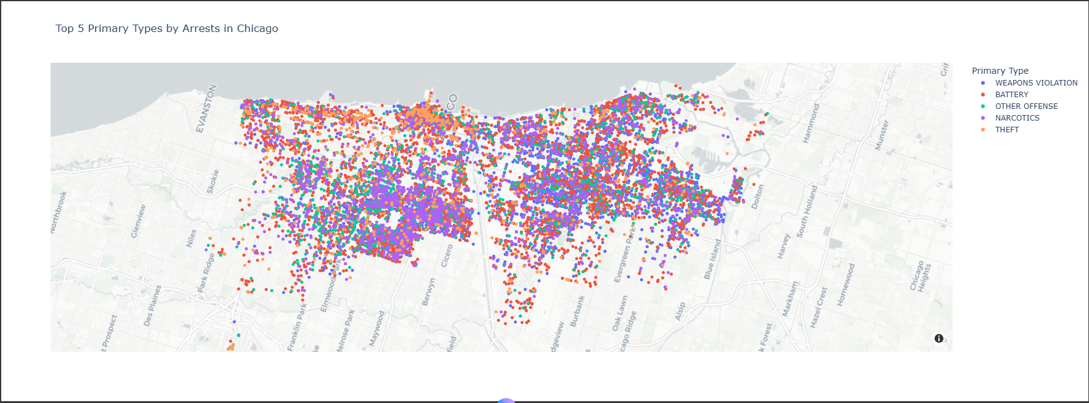
Methodology– Visualization
5 Top crimes by total arrests:

Slide 18
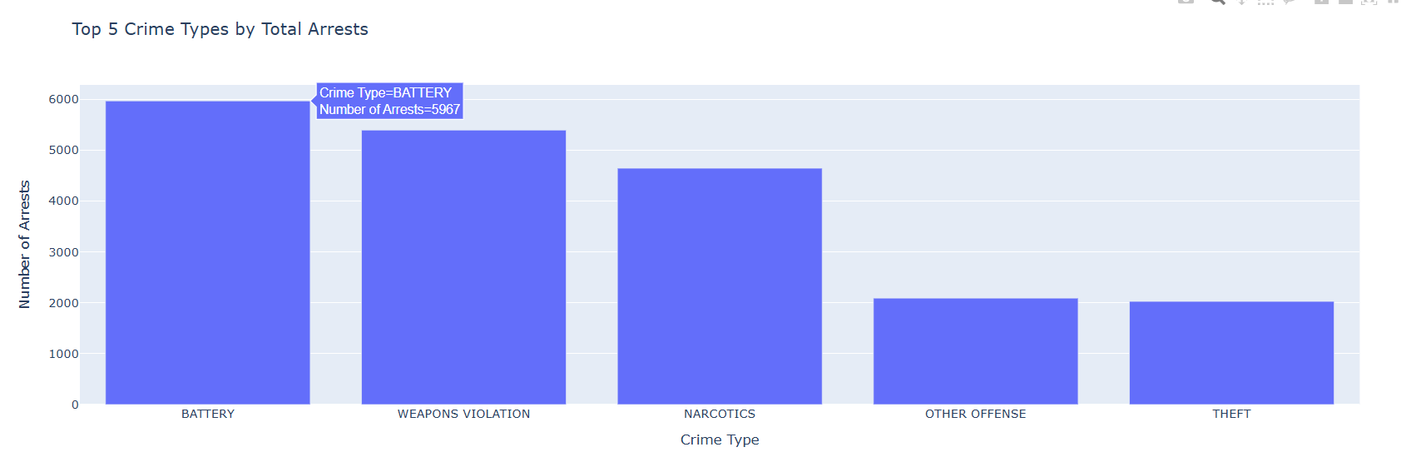
Methodology– Visualization
5 Top crimes by total arrests:

Slide 19
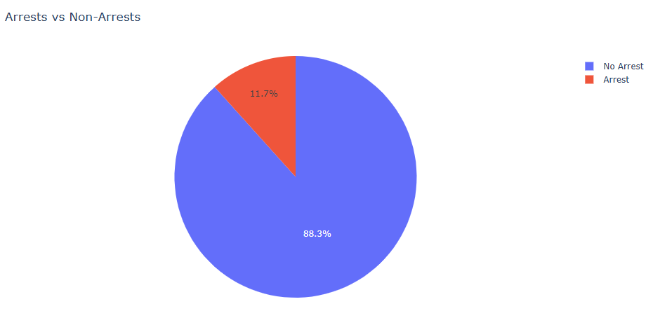
Methodology– Visualization
Arrests VS Non-Arrests :
Non-Arrests
207,494
Arrests
27,361

Slide 20
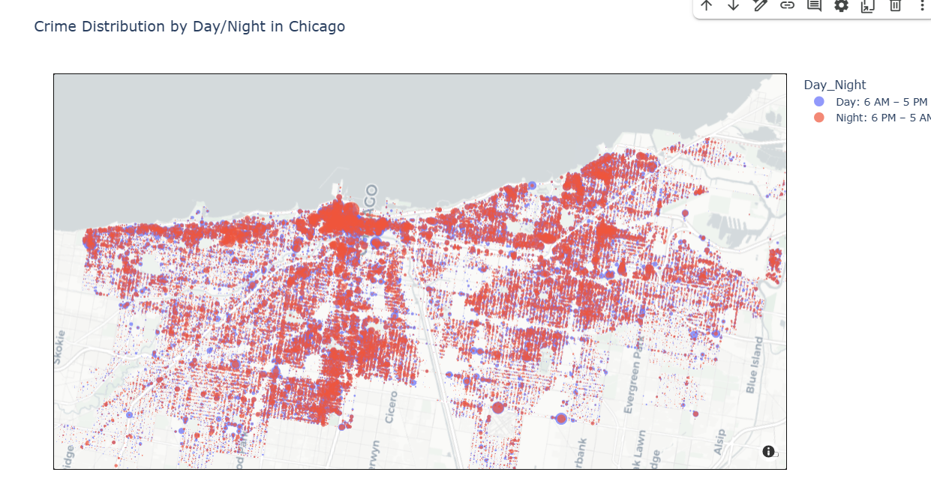
Methodology– Visualization
Day VS Night Crimes:

Slide 21
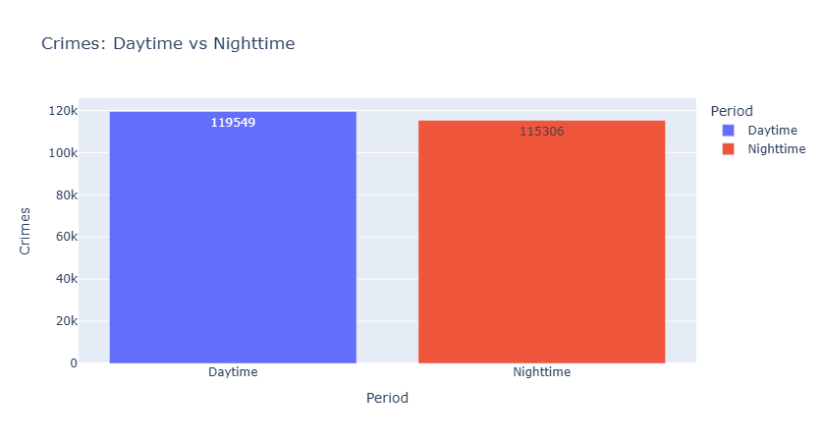
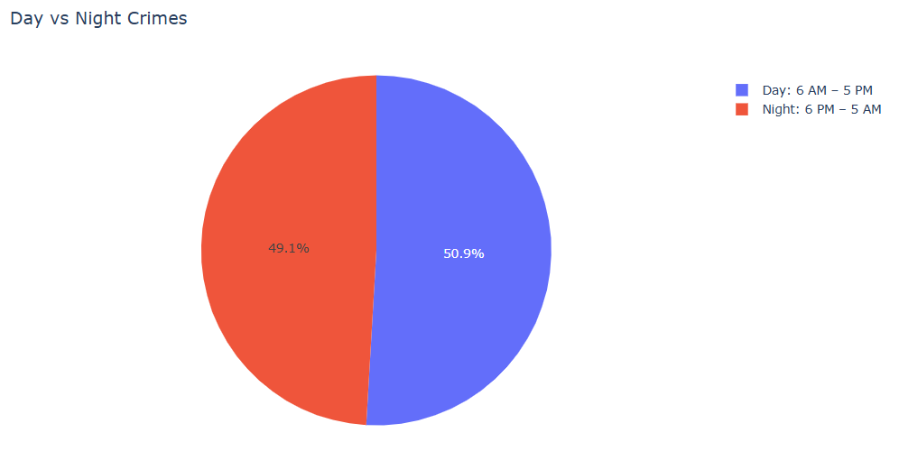
Methodology– Visualization
Day VS Night Crimes:
Day Count
119,549
Night Count
115,306

Slide 22
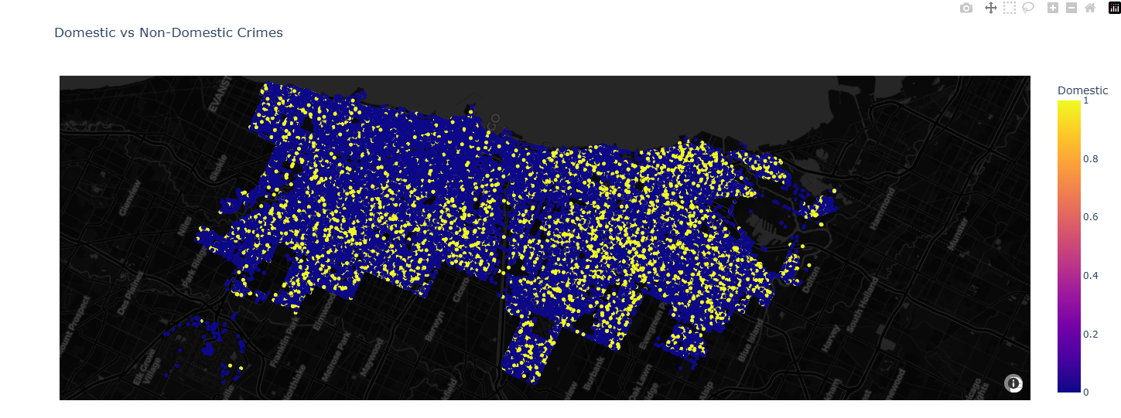
Methodology– Visualization
Domestic VS Non-Domestic Crimes:

Slide 23
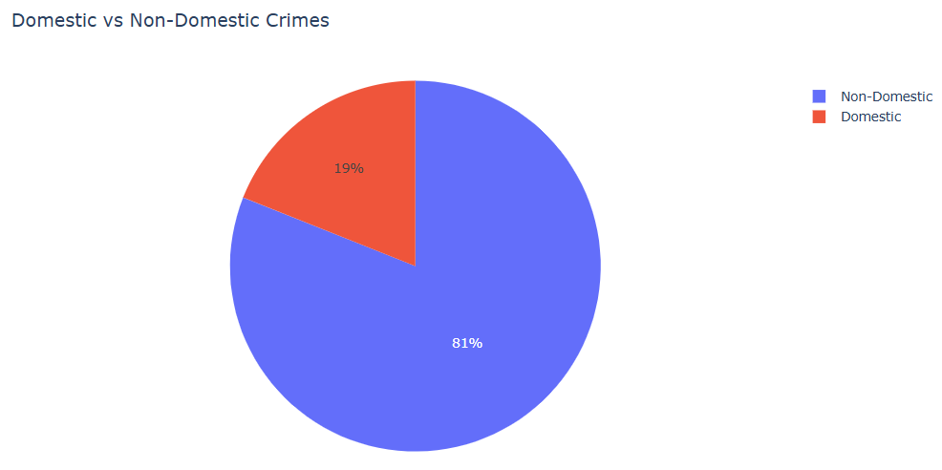
Methodology– Visualization
Domestic VS Non-Domestic Crimes:
Non-Domestic: 190,326
Domestic:
44,529

Slide 24
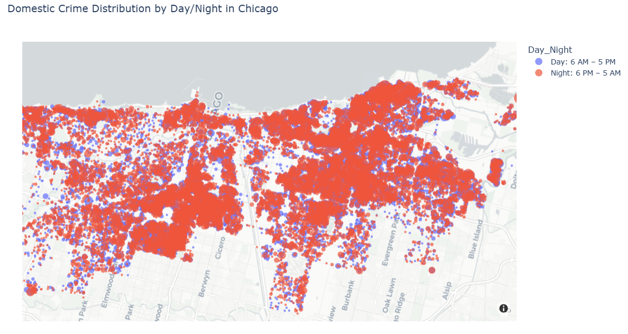
Methodology– Visualization
Domestic Crimes Day VS Night Crimes:

Slide 25
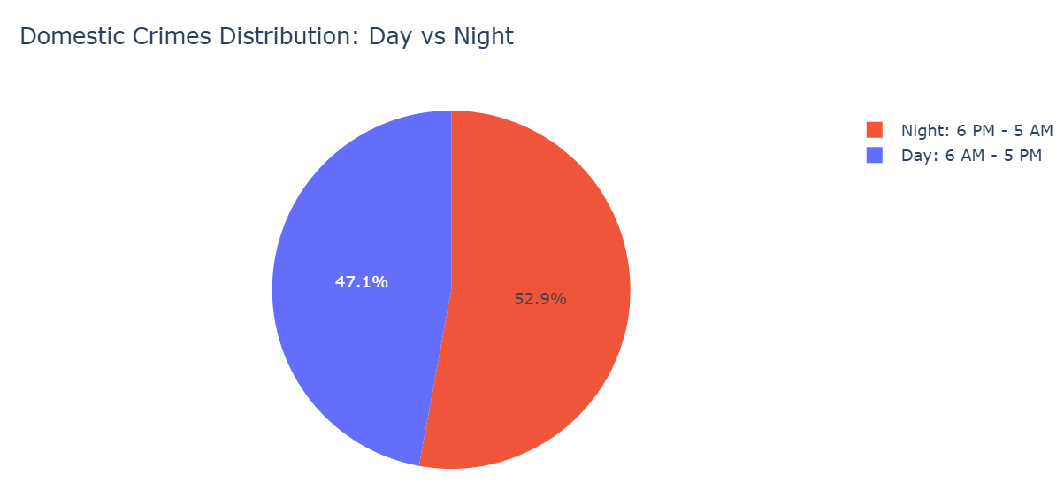
Methodology– Visualization
Domestic Crimes Day VS Night Crimes:
Day count:
20,980
Night count:
23,549

Slide 26
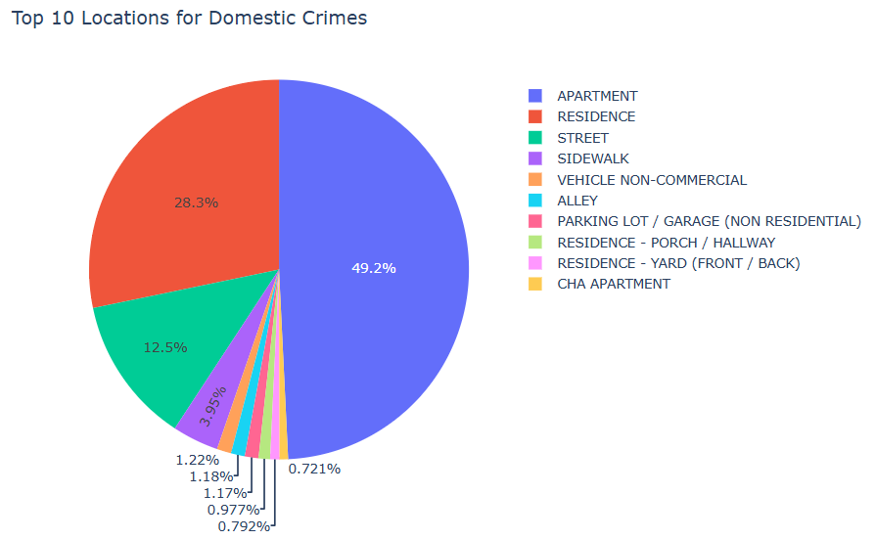
Methodology– Visualization
Domestic Crimes type count & Top 10 locations::
Crime Type | Domestic count
Battery | 22146
Assault | 5986
Other Damage | 5751
Criminal Damage | 3958
Theft | 2711

Slide 27
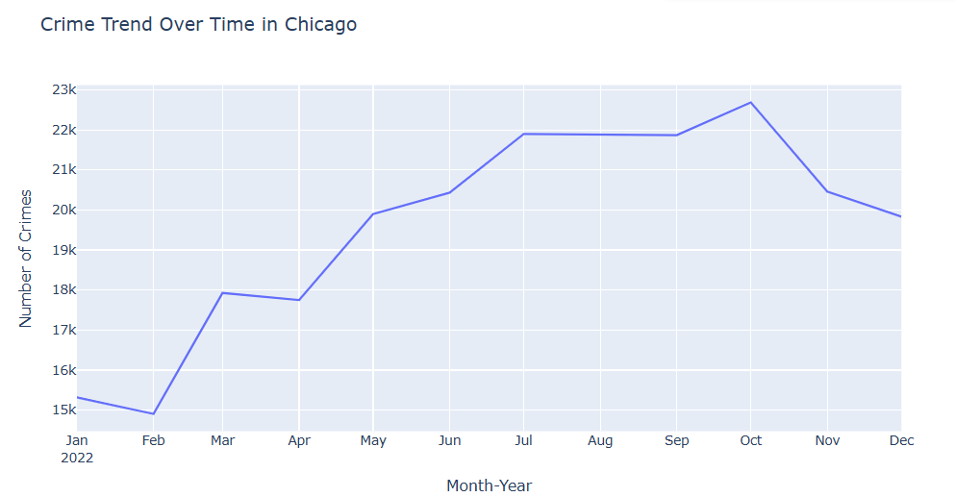
Methodology– Visualization
Crime Trend over time:

Slide 28
Dashboard & Key Insights
Most frequent crime types: theft, battery, narcotics
Areas with highest crime density (map visual)
Peak crime times: day vs. night, weekdays vs. weekends
Interactive maps reveal hotspots for targeted policing

Slide 29
Conclusion
Data-driven insights reveal geospatial crime patterns in Chicago effectively
Streamlit dashboard allows interactive exploration for decision-making
Limitations: only reported crimes included, some data may be missing

Slide 30
Thank you
2025

Slide 31
Appendix
2025

Slide 32
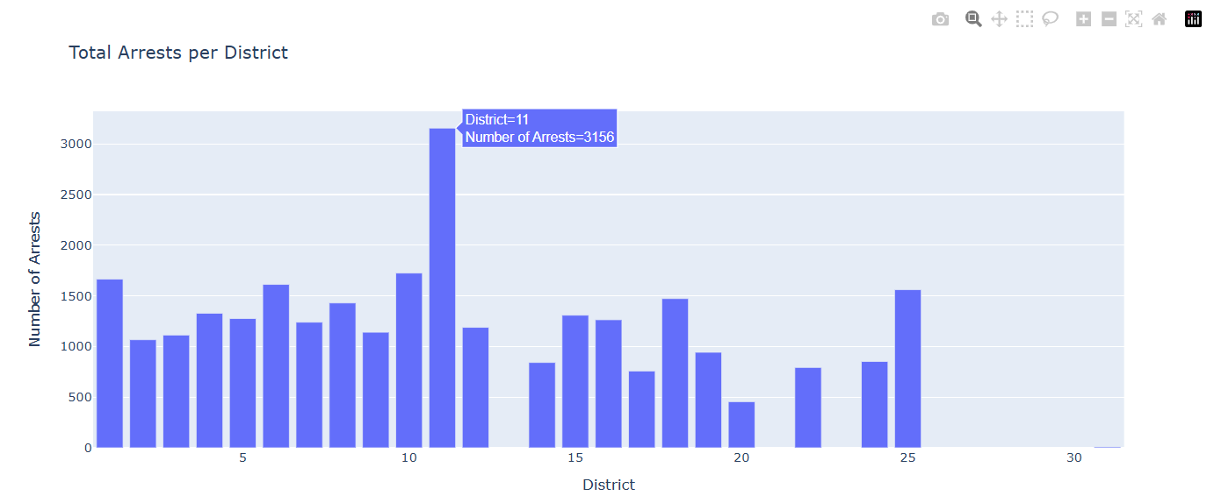
Additional Visualization
Total Arrest count per district :

Slide 33
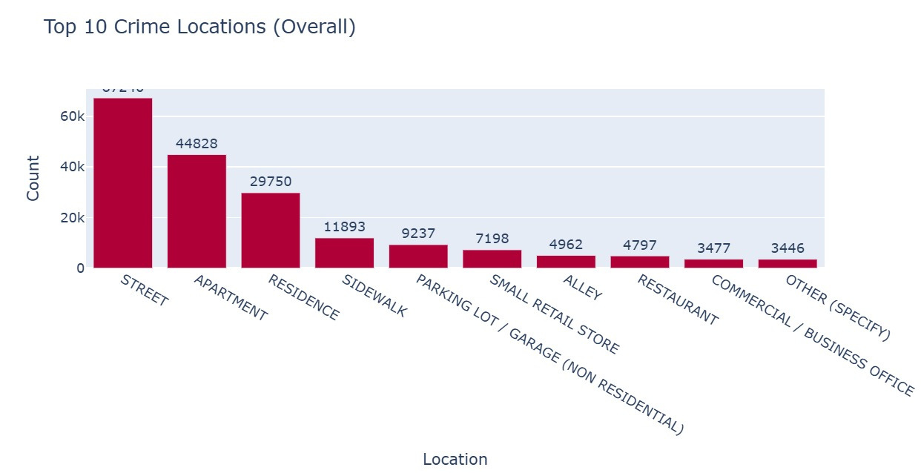
Additional Visualization
Top 10 Crime Locations::

Slide 34
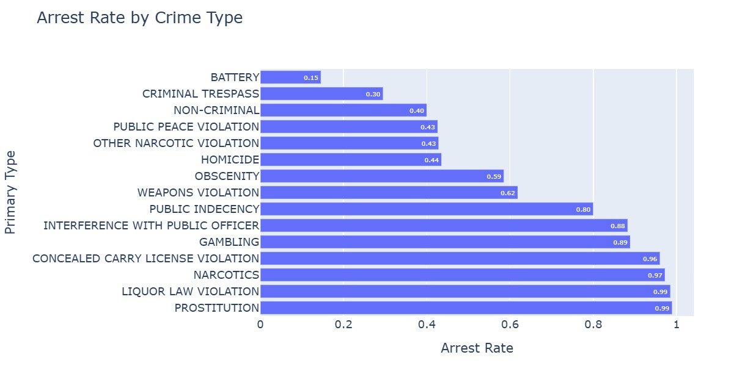
Additional Visualization
Arrest rate by crime type: :

Slide 35
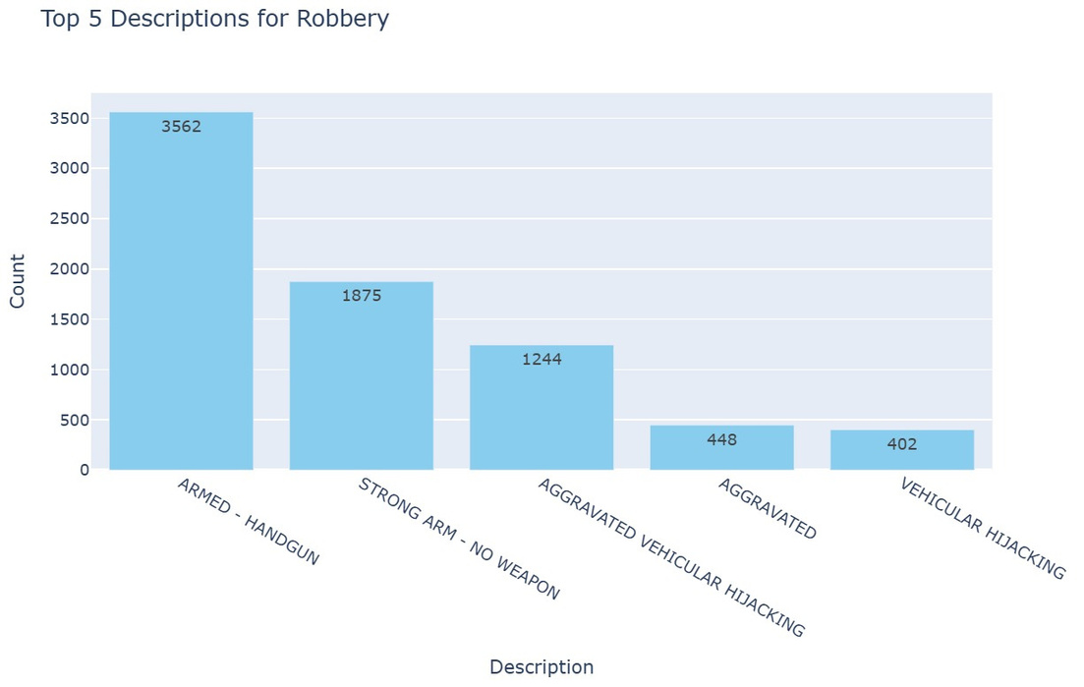
Additional Visualization
Top 5 descriptions for Robbery:

Slide 36
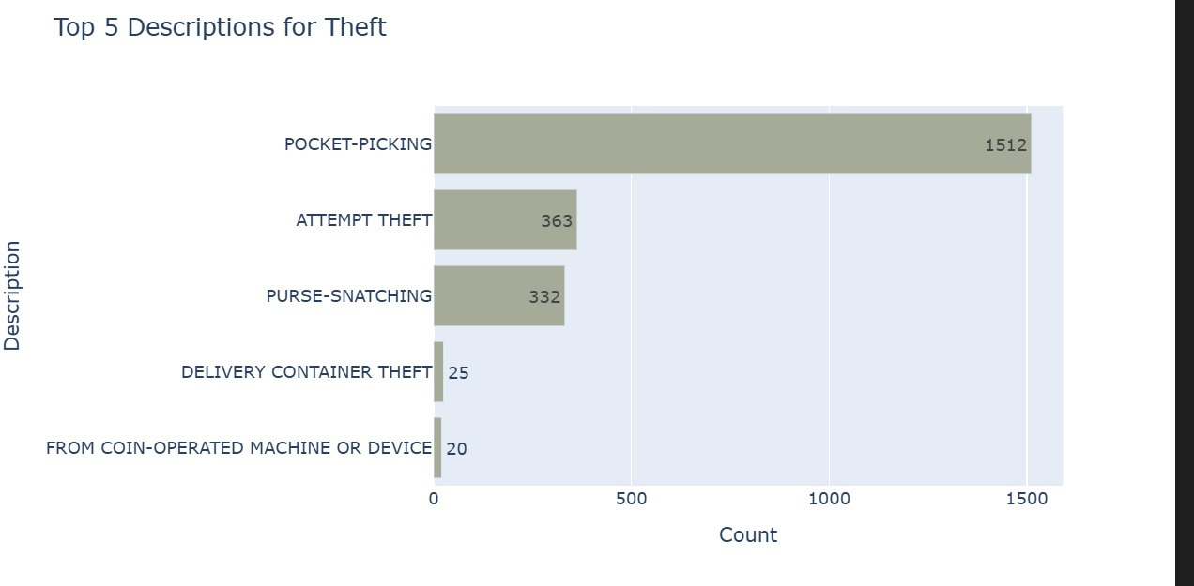
Additional Visualization
Top 5 descriptions for theft:

Slide 37
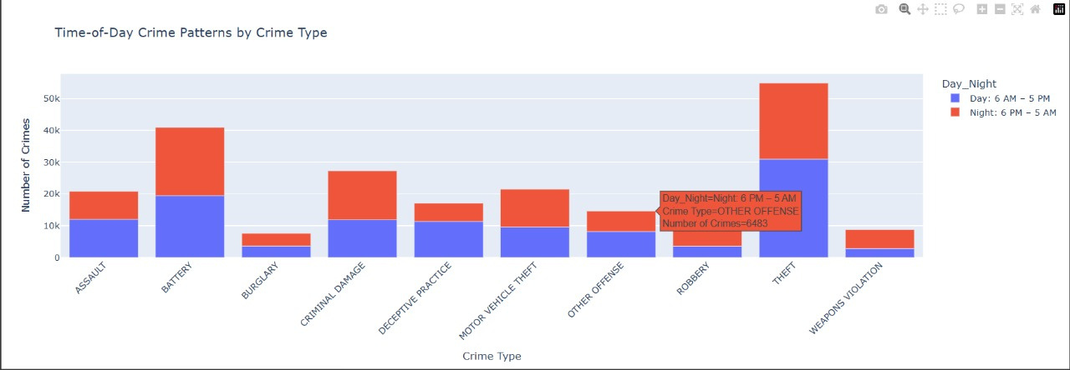
Additional Visualization
Crime time pattern by type of crime:

